Slide 1
Student Performance Monitor
Submitted by group 2

Slide 2
Prepared by
Muhammad fahimul huq 1610044
Shoban Bhowmik 1930533
Airin Sikder Onamika 1822098
Kazi Tokir Ahmed Shawon 1821890
Md Takbir 1822068

Slide 3
INTRODUCTION
Student progress monitoring is a practice that helps teachers continually evaluate the effectiveness of their learning and use student performance data to make more significant instructional decisions. If the rate at which a particular student is learning seems inadequate, the teacher can adjust the instruction. Our project seeks to create user-friendly software that will serve as a platform for many to improve the quality of education of students, faculty, and other members of the university and in advanced technology in the field of education. We believe that the information we have collected, evaluated, and equipped will lead to opportunities for greater advances in our education and will also make a significant contribution to computer science.

Slide 4
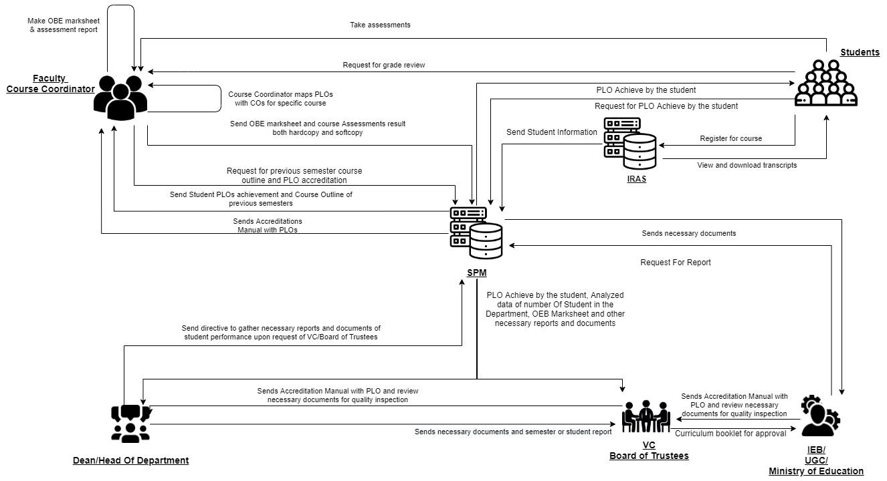
Rich Picture

Slide 5
Problem Analysis
Process Name | Stakeholders | Concerns (Problems) | Analysis (reason of the problem) | Proposed solution
Map course outcomes (COs) to program Learning Outcomes (PLOs) | 1.Faculties | 1.VC has to collect and send CO and PLO data to the Dean. 2.Dean sends data to department head and then it is passed to department. 3.Course instructor implements CO and PLO in their course. | The process is very complicated and time consuming as faculties must wait for other non-essential stakeholders to implement PLO and CO in their courses. | We can eliminate the involvement of department by giving faculties direct access to update PLOs and COs in our software and department head to update the PLO after further inspection

Slide 6
Process Name | Stakeholders | Concerns (Problems) | Analysis (reason of the problem) | Proposed solution
Check number of student enrollment in a department | 1.Department 2.Dean | 1.Register office collects all the new student’s information. 2.Register office sends updated data to each department. 3.Department updates data to database. Then sends new data to Dean. 4. Dean makes calculation to see student enrollment comparison. | Same information is being send to different stakeholders individually. Which creates unnecessary repetition. Which makes the overall process time consuming. | We can make this information centralized, so that all the stakeholders can see latest information any time. We can also generate custom comparison Graphs/charts for any individual stakeholder.

Slide 7
Process Name | Stakeholders | Concerns (Problems) | Analysis (reason of the problem) | Proposed solution
Record Student Assessment Data to SPM | 1.Faculty | 1. Faculty had to calculate the total assessments marks and convert finals and midterms Marks of each student. 2. Bring all the marks of every student for a course into a Marksheet. 3. Grade the student | Making all the calculation manually is too much time consuming and chances human error is greater. | All the calculation can be done in SPM and graded accordingly. Adjustment in marks distribution can easily be made if change is needed

Slide 8
Process Name | Stakeholders | Concerns (Problems) | Analysis (reason of the problem) | Proposed solution
Produce OBE Marksheet & Course Assessment Report | 1.Faculty | 1. All calculation have to done manually 2. Need to send data to register office to update database | Making all the calculation manually and waiting for register office to update data is too much time consuming and chances human error is greater. | Calculation can be done by the help of the software and OEB marksheet can directly uploaded to database using the software

Slide 9
Process Name | Stakeholders | Concerns (Problems) | Analysis (reason of the problem) | Proposed solution
View records, OBE marksheets and Course assessment report | 1.IEB/UGC 2.Dean 3.VC 4.Faculty | 1. Faculty can’t access the OEB marksheet directly 2. Calculations have to done manually and charts have to make manually to make comparison | Too many manual processes which takes time and resource. Therefore, lowers overall efficiency | We will generate automated charts, graphs and report for relevant stakeholder. we can collect most of the relevant data directly from IRAS, which will eliminate any extra steps. Faculty can view OEB marksheet of past semesters.
Request for review and change grade | 1.Faculty | 1. Faculty need to send request to register office to change the grade | Grade change could be done by faculty. Sending request to register office for grade upgrade adds extra work. | By giving access to change grade in our system we could eliminate the involvement of register office in our system.

Slide 10
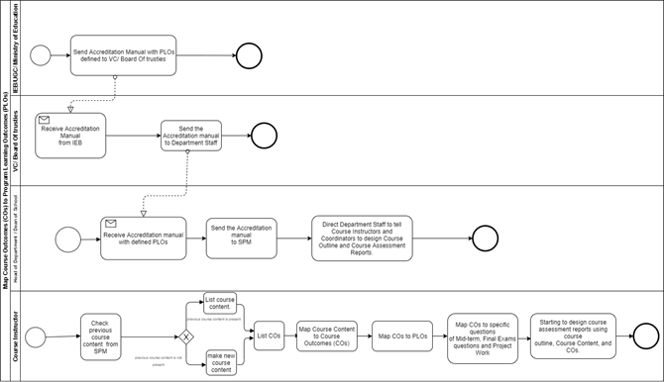
PROCESS DIAGRAM
Figure 2.12: Process diagram for Map Course Outcomes (COs) to Program Learning Outcomes (PLOs)

Slide 11
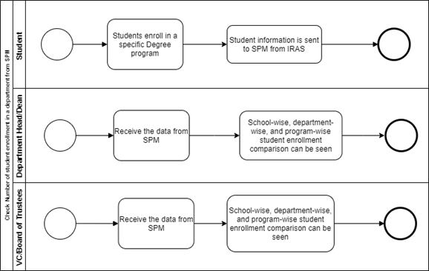
Figure 2.13: Process diagram for Check Number of student enrollment in a department from SPM

Slide 12

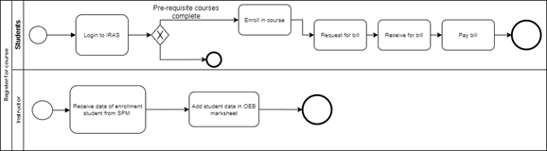
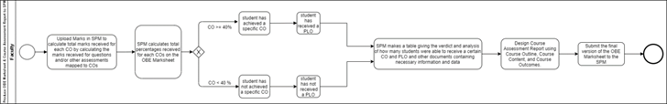
Figure 2.14: Process diagram for Record Student Assessment Data to SPM
Figure 2.15: Process diagram for Register for course
Figure 2.16: Process diagram for Produce OBE Marksheet & Course Assessment Report to SPM

Slide 13
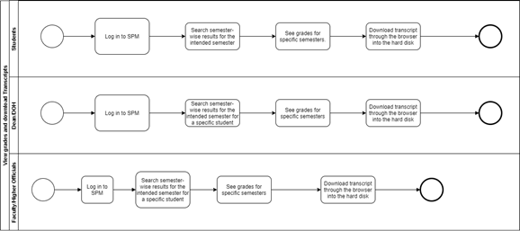
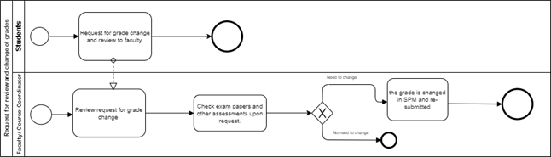
Figure 2.17: Process diagram for View grades and download Transcripts
Figure 2.20: Process diagram for Request for review and change of grades

Slide 14
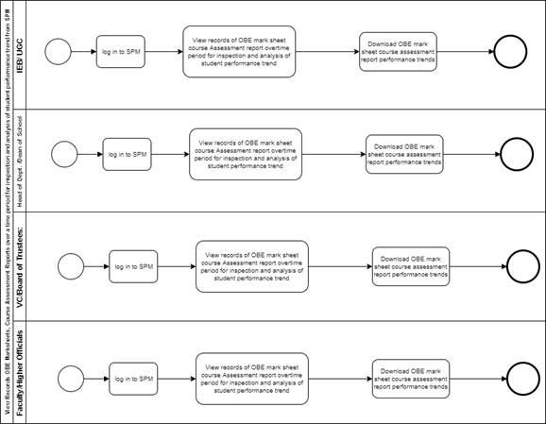
Figure 2.19: Process diagram for View Records OBE Marksheets, Course Assessment Reports over a time period for inspection and analysis of student performance trend from SPM

Slide 15
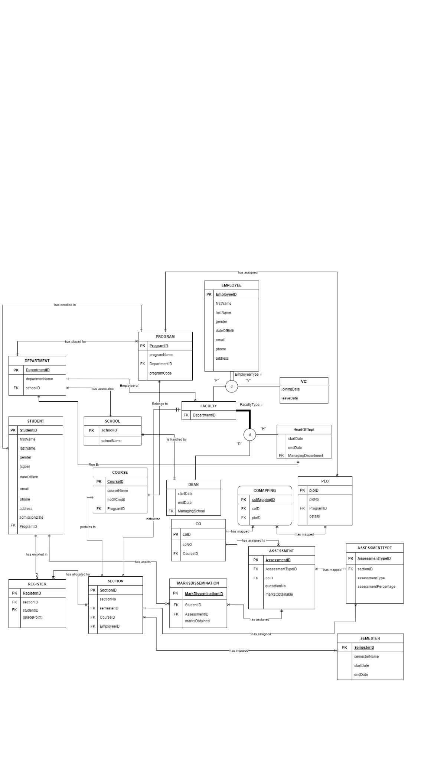
ERD
Entity Relational Diagram
https://drive.google.com/file/d/1Cu1G1TOa9wxS6s0Wjqato0Xy1Ti-LlYe/view

Slide 16
Importance of ERD :
The graphical diagram to understand the whole project.
Components of data are called entity .
Defines the relation of the joins.
Defines the attribute of the relation.

Slide 17
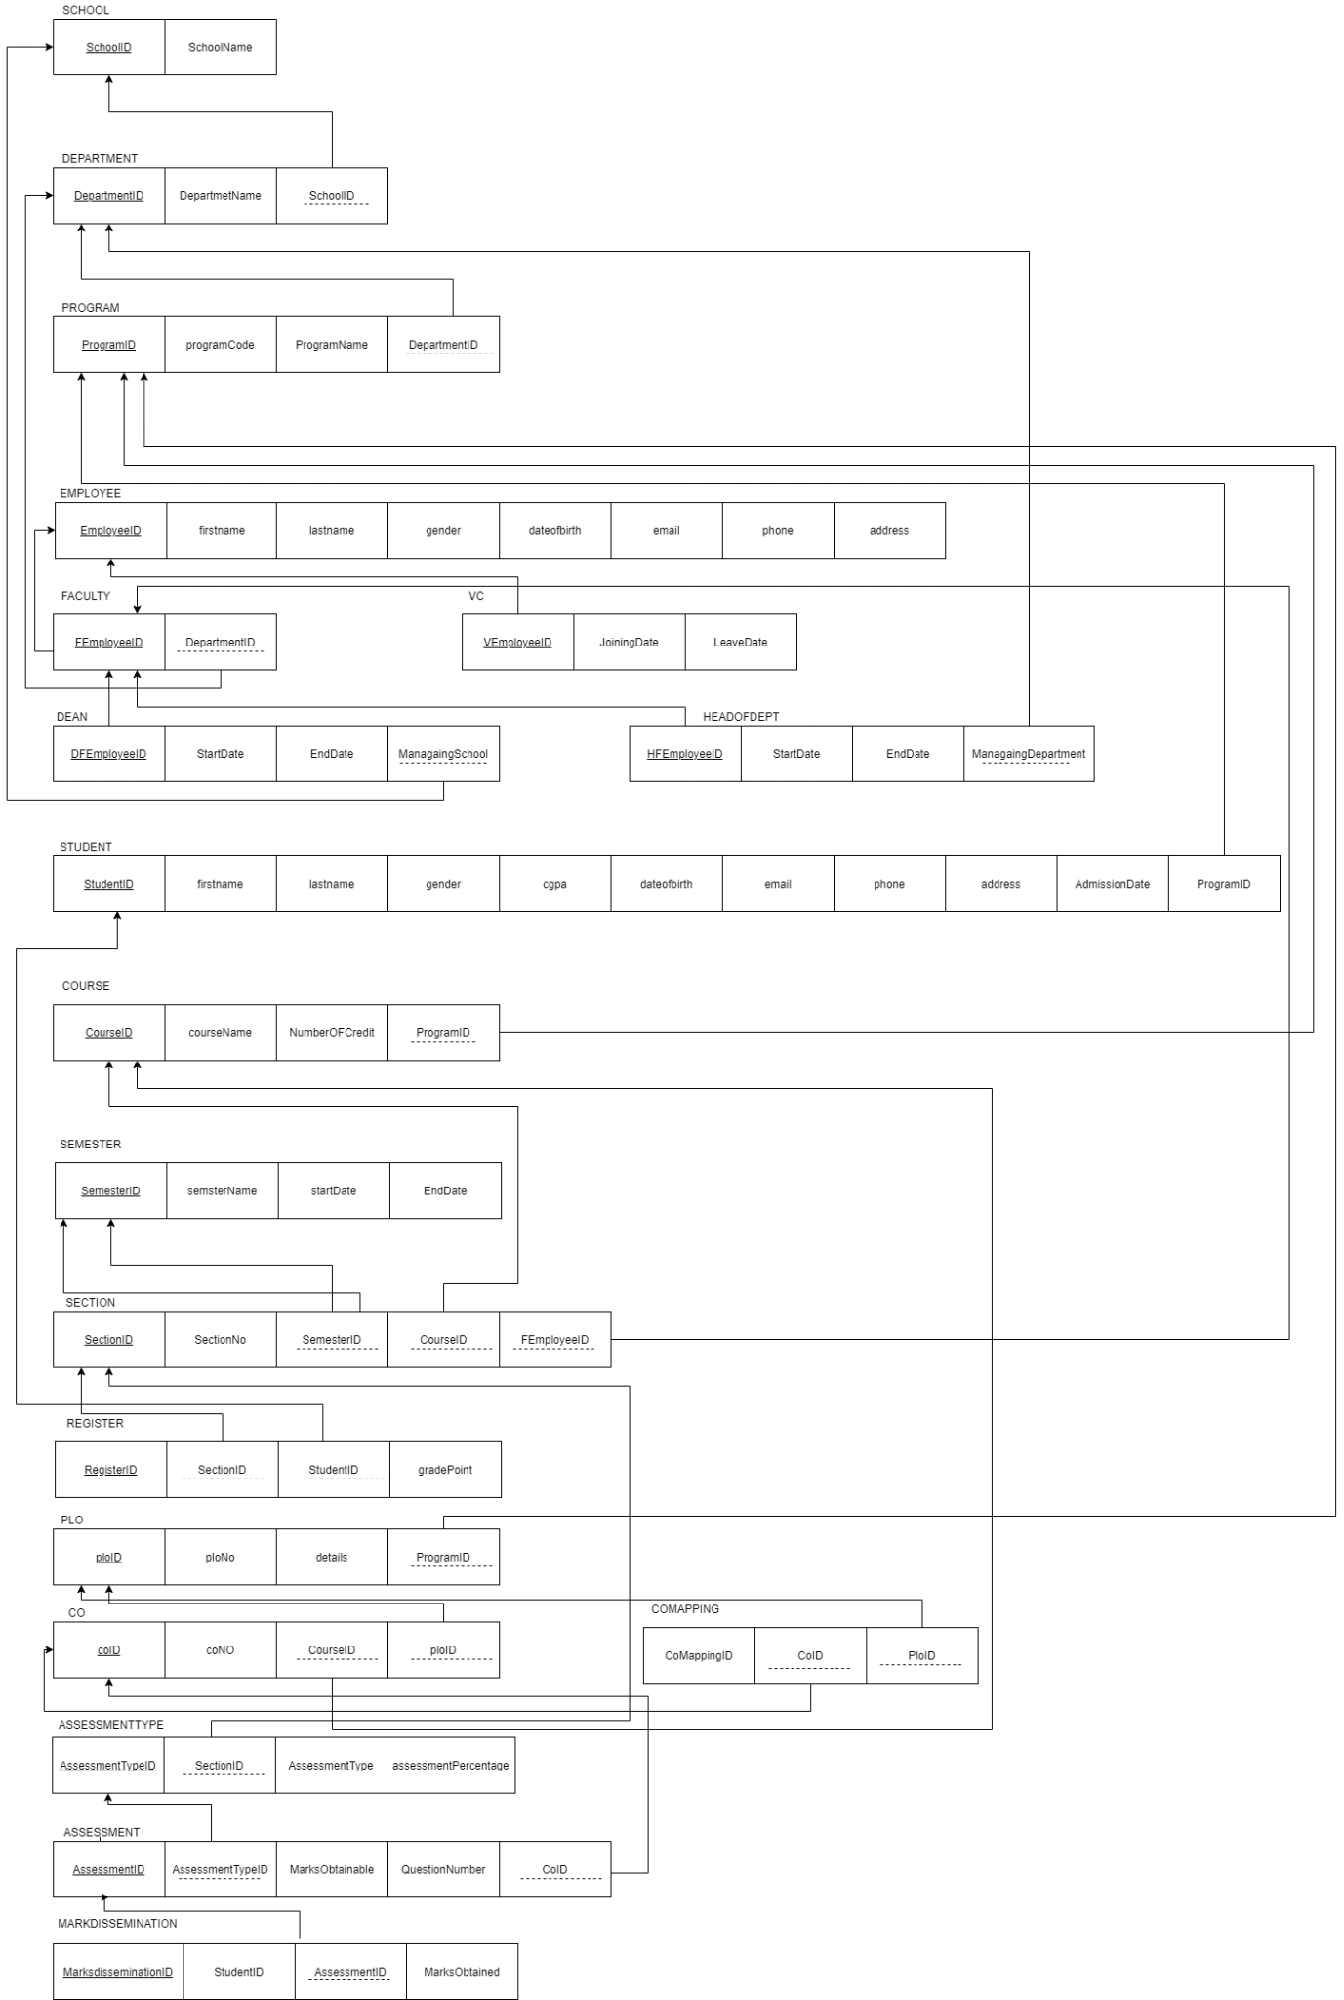
ENTITY RELATIONSHIP DIAGRAM TO RELATIONAL SCHEMA
https://drive.google.com/file/d/1vr9jQy-yc-FUI-zIG_sEZTZojKujStfm/view

Slide 18
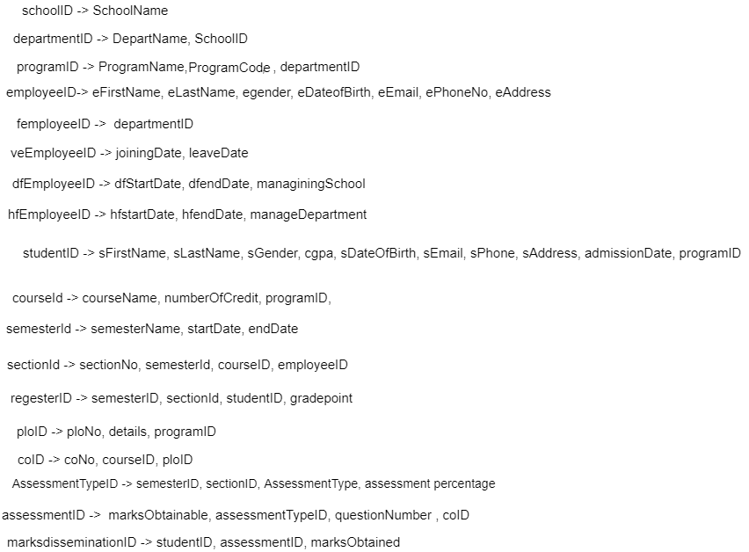
NORMALIZATION

Slide 19
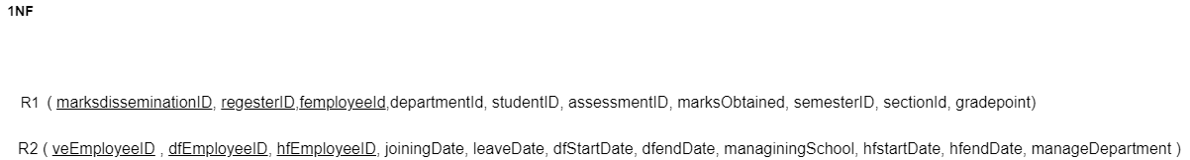
1NF

Slide 20
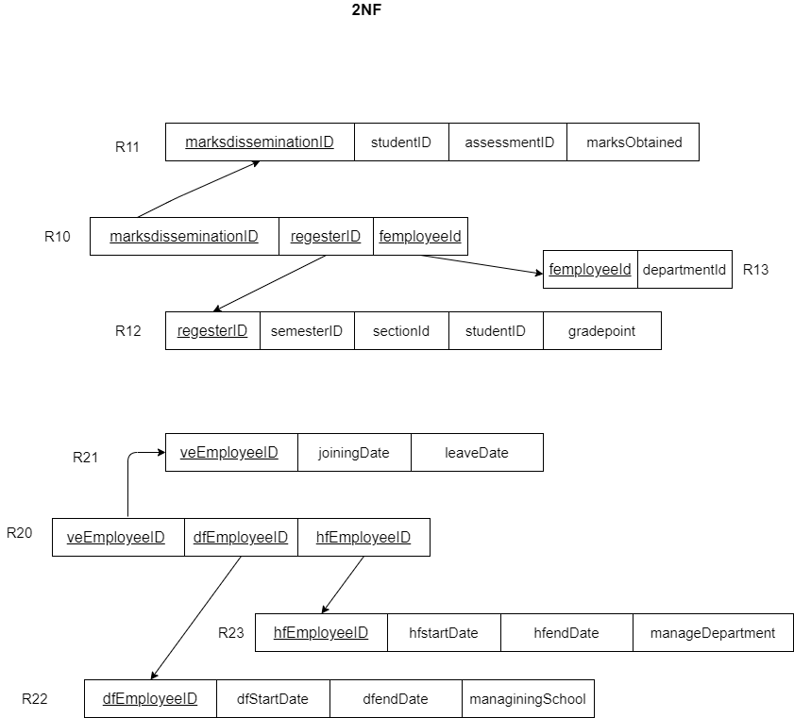
2NF

Slide 21
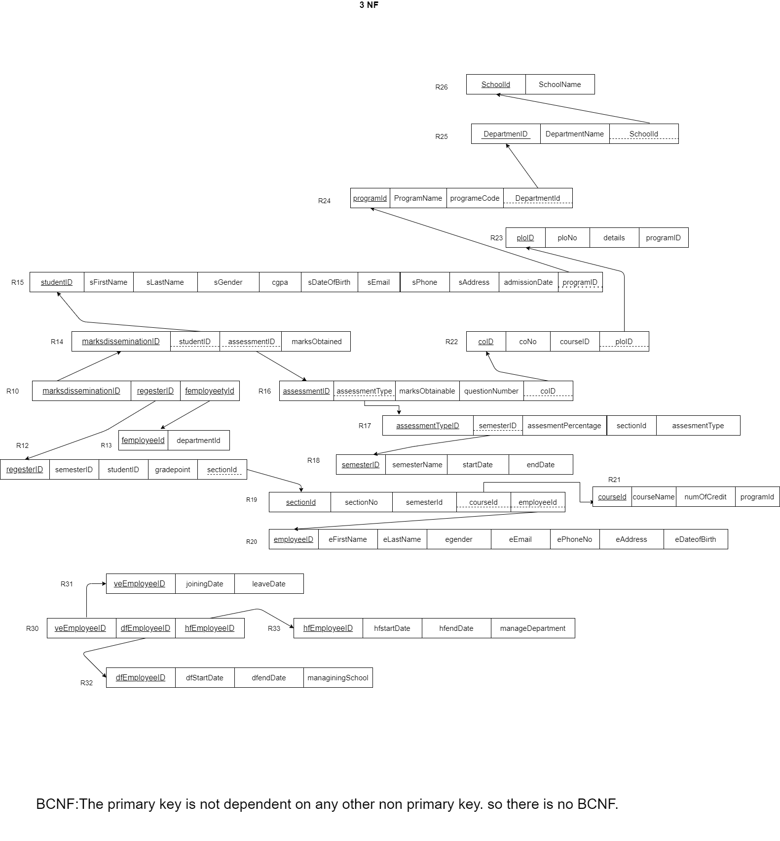
3NF
BCNF

Slide 22
Data Dictionary
Schools_T
Name | Data Type | Size | Remark
nschoolID | BIGINT | 20 | This is the Primary Key of School Example: “1”
cschoolName | VARCHAR | 255 | This is the name of the School. Example: “School of Engineering, Technology and Science”

Slide 23
Departments_T
Name | Data Type | Size | Remark
cdepartmentID | VARCHAR | 255 | This is the Primary Key of the Department. Example: “CSE”
cdepartmentName | VARCHAR | 255 | This is the name of the Department. Example: “Computer Science and Engineering”
nschool_id | BIGINT | 20 | This is the Foreign Key of the table School. Example: “1”

Slide 24
Courses_T
Name | Data Type | Size | Remark
ccourseID | VARCHAR | 255 | This is the Primary Key for the Course. Example: “CSE203”
ccourseName | VARCHAR | 255 | This is the name of the Course. Example:” Data Structure”
nnoOfCredits | INTEGER | 11 | This is the credit for the Course. Example: ”3”
cprogram_id | VARCHAR | 255 | This is the Foreign Key from Program table Example:” 1”.

Slide 25
Employees_T
Name | Data Type | Size | Remark
nemplyeeID | BIGINT | 20 | This is the Primary Key for Faculty. Example: “1803”
cfname | VARCHAR | 255 | This is the first name of the Faculty. Example: “​Sadita”
clname | VARCHAR | 255 | This is the last name of the Faculty Example: “Ahmed”
ddateOfBirth | DATE | DD-MM-Y | This the Date of Birth of the Faculty YYY Example: “01-01-1993”
cgender | VARCHAR | 255 | This is the gender of the Faculty. Example: “F”
cemail | VARCHAR | 255 | This is the email address of the Faculty. Example: “sadita@iub.edu.bd”
cphone | VARCHAR | 255 | This is the phone number of the Faculty. Example: “01292383111”
caddress | VARCHAR | 255 | This is the address of the Faculty. Example: “House 1, Road 1, Sector 1, Area, Dhaka, Bangladesh,

Slide 26
Programs_T
Name | Data Type | Size | Remark
cprogramID | VARCHAR | 255 | This is the Primary Key of the program. Example: “EEE”
cprogramCode | VARCHAR | 255 | This is the program name in short form for a Program Example:”B.Sc”.
cprogramName | VARCHAR | 255 | This is the name of the Degree Program. Example: “Bachelor of Science”
cdepartment_id | VARCHAR | 255 | This is the Foreign Key from the Department table. Example: “CSE”

Slide 27
Faculties_T
Name | Data Type | Size | Remark
nFemplyeeID | BIGINT | 20 | This is the Primary Key for Faculty. Example: “1803”
cdepartment_id | BIGINT | 20 | This is the Foreign Key from the Department table. Example: “CSE”
vcs_T
Name | Data Type | Size | Remark
nvemployeeID | BIGINT | 20 | This is the Primary Key for employees. Example: “1803”
djoiningDate | DATE | YYYY-MM-DD | The date when the employee assigned in the job. Example “2012-12-05”
dleaveDate | DATE | YYYY-MM-DD | The date when the duration of assigned job end. Example “2016-12-05”

Slide 28
Deans_T
Name | Data Type | Size | Remark
nDFemployeeID | BIGINT | 20 | This is the Primary Key for Faculty. Example: “1803”
djoiningDate | DATE | YYYY-MM-DD | The date when the employee assigned in the job. Example “2012-12-05”
dleaveDate | DATE | YYYY-MM-DD | The date when the duration of assigned job end. Example “2016-12-05”
nmanagingSchool | BIGINT | 20 | This is the foreign Key from the Schools table Example: “1”

Slide 29
HeadOfDepts_T
Name | Data Type | Size | Remark
nHFemployeeID | BIGINT | 20 | This is the Primary Key for Faculty. Example: “1803”
djoiningDate | DATE | YYYY-MM-DD | The date when the employee assigned in the job. Example “2012-12-05”
dleaveDate | DATE | YYYY-MM-DD | The date when the duration of assigned job end. Example “2016-12-05”
nmanagingDepartment | BIGINT | 20 | This is the foreign Key from the departments table Example: “1”

Slide 30
Students_T
Name | Data Type | Size | Remark
cstudentID | BIGINT | 20 | This is the Primary Key for the Students. Example: “1800001”
cfname | VARCHAR | 255 | This is the first name of the Student. Example: “Shoban”
clname | VARCHAR | 255 | This is the last name of the Student. Example: “Bhowmik”
ddateOfBirth | DATE | DD-MM- YYYY | This the Date of Birth of the Student. Example: “1998-01-01”
cgender | VARCHAR | 255 | This is the gender of the Student. Example: “M”
cemail | VARCHAR | 255 | This is the email address of the Student. Example: “1850105@iub.edu.bd”
cphone | VARCHAR | 255 | This is the phone number of the Student. Example: “0191211141”
caddress | VARCHAR | 255 | This is the address of the Student. Example: “House 1, Road 1, Sector 1, Area, Dhaka, Bangladesh”

Slide 31
ncgpa | FLOAT | 53 | This is the cgpa of the Student. Example: 4.00
dadmissionDate | DATE | DD-MM- YYYY | This the Date of admission of the Student. Example: “2016-01-01”
cprogram_id | VARCHAR | 255 | This is the Foreign Key from Programs table Example:” B.Sc”.

Slide 32
Sections_T
Name | Data Type | Size | Remark
nsection_id | BIGINT | 20 | This is the Primary Key for Sections
nsectionNo | INTEGER | 11 | This is the section number. Example: “1”
ccourse_id | VARCHAR | 255 | This is the foreign key from the Courses table. Example: “CSE101”
nFemployee_id | BIGINT | 20 | This is the foreign key from Faculties table Example: “108051”
nsemester_id | BIGINT | 20 | This is the foreign key from semesters table Example: “1”

Slide 33
Registers_T
Name | Data Type | Size | Remark
nregisterID | BIGINT | 20 | This is the Primary Key for Registers
nSemisterID | BIGINT | 20 | This is the Foreign Key from semesters table
nsection_id | BIGINT | 20 | This is the Foreign Key from sections table
nstudent_id | BIGINT | 20 | This is the Foreign Key from students table
ngradePoint | FLOAT | 53 | This is the grade value for each course. Example “3.7”

Slide 34
Semesters_T
Name | Data Type | Size | Remark
nsemester_id | BIGINT | 20 | This is the Primary Key for semester
csemesterName | VARCHAR | 255 | This is the name of the semester. Example: “summer19”
dstartDate | DATE | YYYY-MM-DD | The date when the semester starts. Example “2012-12-05”
dendDate | DATE | YYYY-MM-DD | The date when the semester end. Example “2013-3-05”

Slide 35
Assessments_T
Name | Data Type | Size | Remark
nassessmentID | BIGINT | 20 | This is the Primary Key for Assessments
nco_id | BIGINT | 20 | This is the Foreign Key from cos table
cmarksObtainable | INTEGER | 11 | This is the question’s mark. Example”30”
cquestionNumber | VARCHAR | 255 | This is the question number. Example “Q1”
nassessmentTypeID | BIGINT | 20 | This is the foreign key from assessmentTypes table

Slide 36
Plos_T
Name | Data Type | Size | Remark
nplo_id | BIGINT | 20 | This is the primary key for Program Learning Outcome. Example: “01”
nplo_no | INTEGER | 11 | This is the PLO NO for Program Learning Outcome. Example: “O1”
cdetails | VARCHAR22 | 255 | This is the details of the Program Learning Outcome. Example: “An ability to select and apply the knowledge, techniques, skills, and modern
cprogram_id | VARCHAR | 255 | This is the foreign key from Programs table Example: ”B.Sc”.

Slide 37
Cos_T
Name | Data Type | Size | Remark
nco_id | BIGINT | 20 | This is the Primary Key cos Outcome. Example: ”1”
nco_no | INTEGER | 11 | This is the number of the Courses Outcome. Example: ”1”
ccourse_id | VARCHAR | 255 | This is the Foreign Key from the Courses table. Example: “CSE101”
MARKSDISSEMINATIONS_T
Name | Data Type | Size | Remark
nmarksdissemination_id | BIGINT | 20 | This is the Primary Key MarksDisseminations Outcome. Example: ”1”
nmarksObtained | INTEGER | 11 | This is the number of the marksObtained. Example: ”50”
nassessmentID | BIGINT | 20 | This is the Foreign Key from the assessment table. Example: “5”
nstudentID | BIGINT | 20 | This is the Foreign Key from the students2 table. Example: “1610044”

Slide 38
ASSESSMENTTYPES_T
Name | Data Type | Size | Remark
nassessmentTypeID | BIGINT | 20 | This is the Primary Key assessmentTypes Outcome. Example: ”1”
cassessmentType | VARCHAR | 255 | This is the assessment type of the assessment. Example: ”Quiz”, ”mid”
nassessmentPercentage | INTEGER | 11 | This is the number of percentage given an assessment Example: “50”
nsectionID | BIGINT | 20 | This is the Foreign Key from the sections table. Example: “8”

Slide 39
COMAPPING_T
Name | Data Type | Size | Remark
ncoMappingID | INTEGER | 20 | This is the Primary Key of comapping Outcome. Example: ”1”
ncoID | BIGINT | 20 | This is the foreign key of cos_T Example: ”7”,
npoID | BIGINT | 20 | This is the foreign key of plos_T Example: ”7”,

Slide 40

Demo Pictures
Registration page

Slide 41
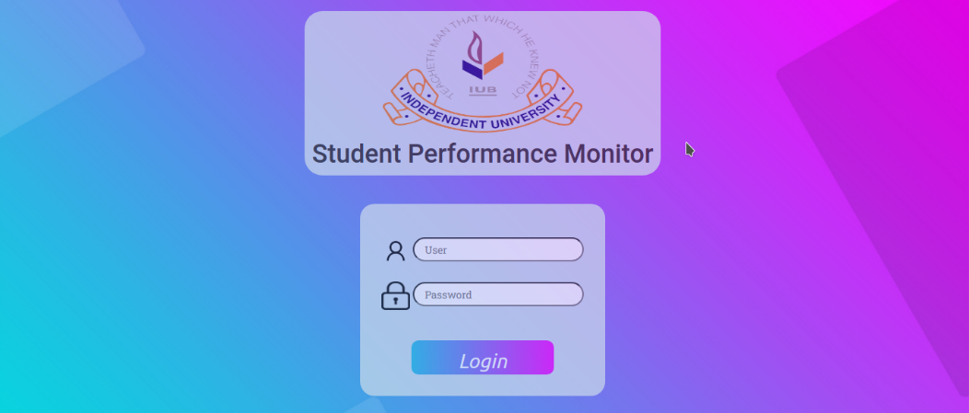
Login Page

Slide 42
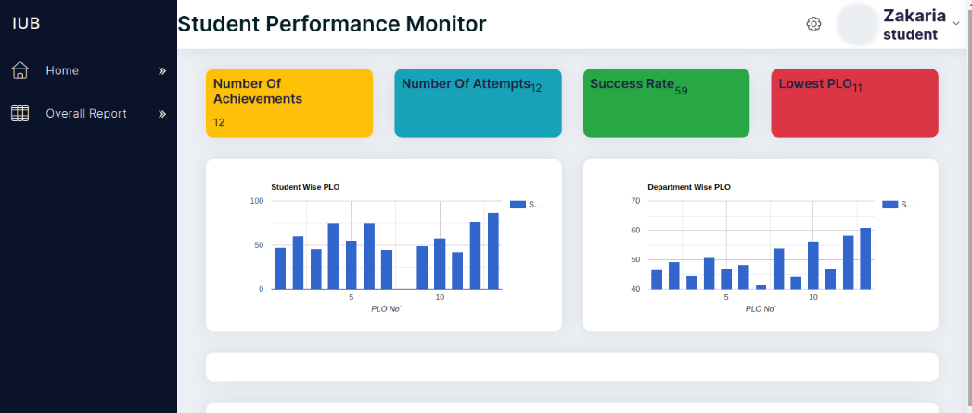
Student Dashboard

Slide 43
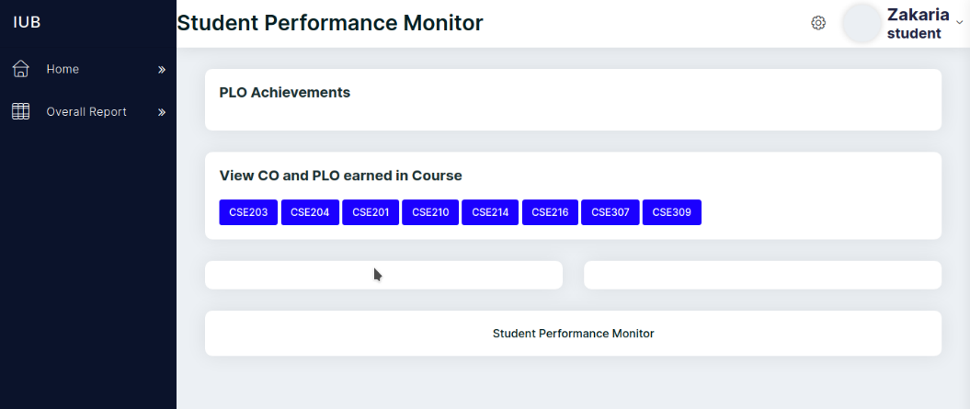

Slide 44
PROBLEM AND SOLUTION
Lack of communication among the team mates.
Not being able to get the most update and accurate data.
Was hard to manage a same database for the ADMINS and STAKEHOLDERS to maintain the work in the same website.
Formatting the data in a proper way, as all the universities has a unique way to upload their file.
The limited time limit of the semester has prevented us from achieving the full potential of this software. If we had to get chances to gain more resources and data to work with, we could believe we could have achieved much more reliable and accurate results, representations and predictions.

Slide 45
ADDITIONAL FEATURES AND FUTURE DEVELOPMENT
1. The addition of an assessment page where faculties will be able to add marks for a specific assessment of a student throughout the term. Our SPM will automatically generate the achieved CO and PLO.
2. Users will be expanded to also include advisors, where advisors will get relevant information about the students they're advising for improved and more beneficial interactions between students and advisors.
3. The addition of Curriculum Page in the SPM where members of the Higher Management team can add and edit any changes to curriculum. Moreover, faculty members and students can check these updates to stay informed about the latest changes.

Slide 46
Conclusion:
In conclusion, our website was designed keeping easy for user. The website has no learning purpose as everything is very simple and basic. It remains user friendly for the users to be able to adapt to the environment in a grasp. Because of our website now this work requires less human involvement, increases efficiency and consumes less time. So we believe that our proposed system is now more beneficial and efficient for this work

Slide 47
Thank You

